Slide 1
Food Chains and Food Webs

Slide 2
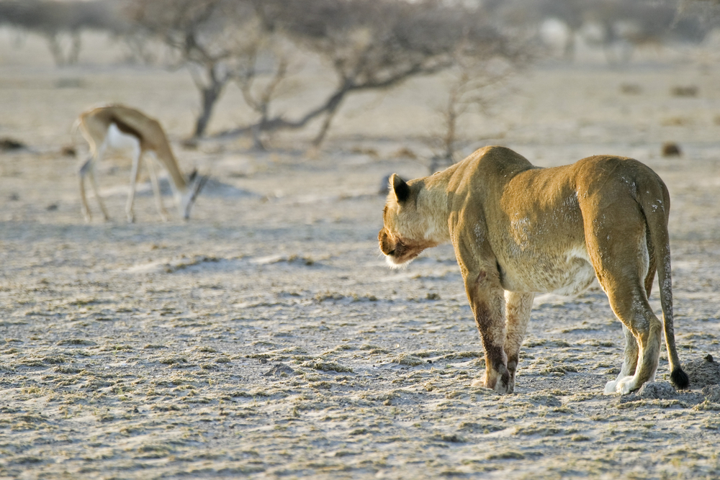
Welcome to this lesson on Food Chains and Food Webs
"Everything you see exists together in a delicate balance. As king, you need to understand that balance and respect all the creatures, from the crawling ant to the leaping antelope." — The Lion King, 1993

Slide 3
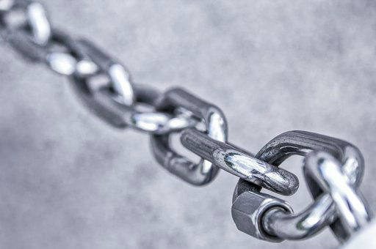
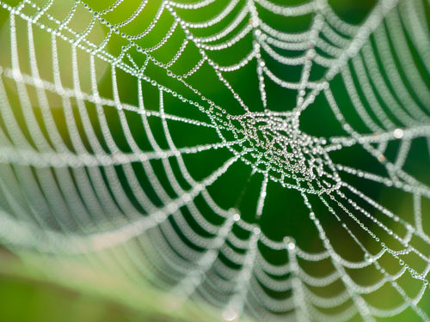
Welcome to this lesson on food chains and food webs. In this lesson, we’ll be learning what these two models of energy transfer actually show us, how we can create our own, and the information we can learn from these models.
By the end of this lesson you should be able to:
Define food webs and food chains.
Interpret food webs and food chains to identify trophic levels and classify producers and consumers.
Construct food webs to illustrate and analyse the movement of energy within ecosystems.
Predict the impact of ecosystem changes based on interpretation of food chains and webs.

Slide 4
In this lesson, we’ll be learning about food chains and food webs. These are both examples of scientific models.
A scientific model is a conceptual representation of ideas or processes. These models are usually based on observations and patterns, and can usually be used to make predictions about things that are difficult to observe directly.
However, scientific models do not explain every aspect of the real-world process they are representing. This means there are limitations and restrictions on how these models can be used. Models are also frequently being improved based on new evidence, to make them more accurate and more useful for making predictions.
Throughout this lesson, it is important to keep in mind that models of food chains and food webs will not be entirely accurate or complete representations of the energy flow within an ecosystem.

Slide 5
Lions eat zebras, and zebras eat grass. This is an example of a food chain.
People eat chickens and chickens eat grains. This is another example of a food chain—one that you might be a part of. Orcas eat sea-lions, sea-lions eat fish, fish eat… ok, I think you’ve got the idea now.
A food chain is a linear pathway of species that depend on the species below them as a source of food. Perhaps a more technical definition is this: a food chain represents a single pathway of chemical energy flow and matter within an ecosystem.
That’s going to be a key point in this lesson; a food chain is really an energy chain. The arrows in food chains show us how energy, which originates from the sun, can be transferred from one species to another, all the way up to apex predators like orcas, lions, and us!

Slide 6
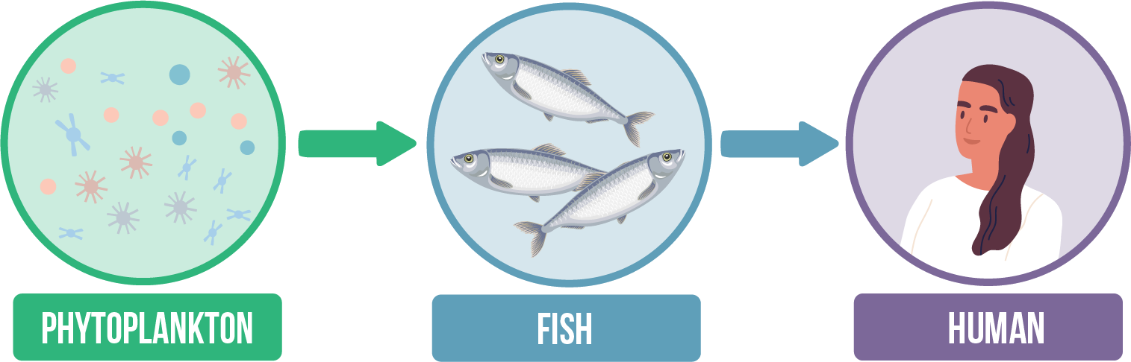

Slide 7
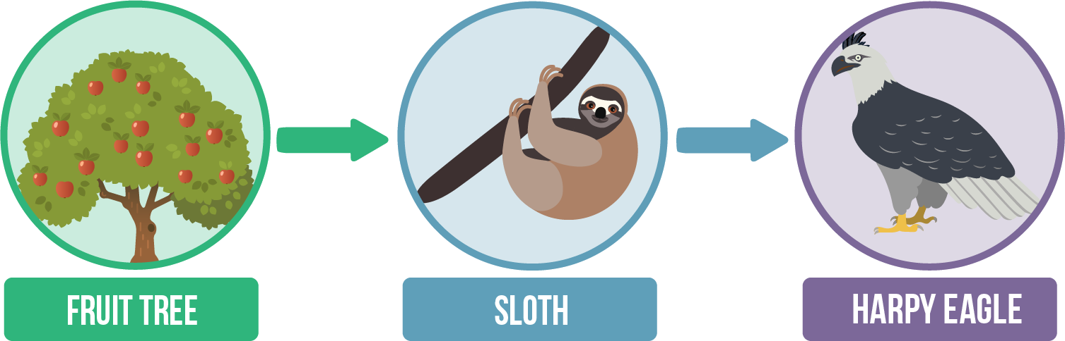
Take a look at the food chain example below.
This food chain demonstrates that sloths eat fruit trees, and harpy eagles eat sloths. In other words, the energy flows from the fruit tree to the sloth, and then to the eagle.

Slide 8
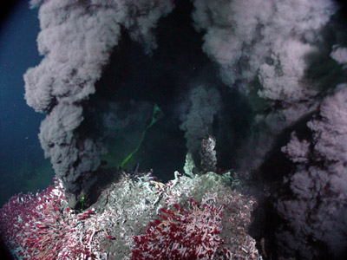
Food chains start with an autotroph, (the producer), which can produce their own food using a source of energy such as sunlight, to carry out the functions they need to survive. Most producers are photosynthetic plants, algae and phytoplankton.
The other species in the food chain are heterotrophs. This means they need to ingest or absorb their nutrients and energy from other organic sources. In other words, they eat things. Hence these organisms are also known as consumers.

Slide 9
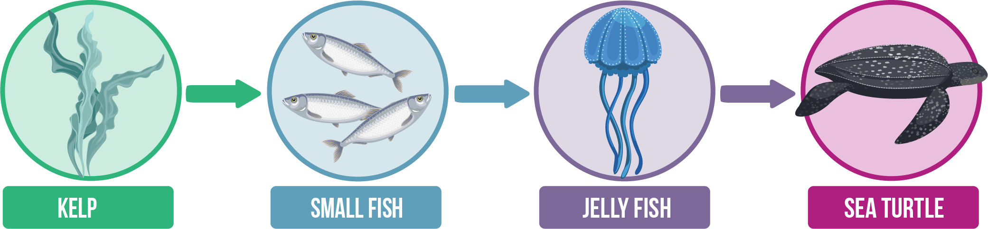
When drawing a food chain, always pay close attention to the direction of the arrows.
Each step of a food chain is separated by an arrow. The arrows in a food chain show the direction of energy flow. This means that the arrow will be pointing away from the species that is being eaten, and towards the species that is eating it.

Slide 10
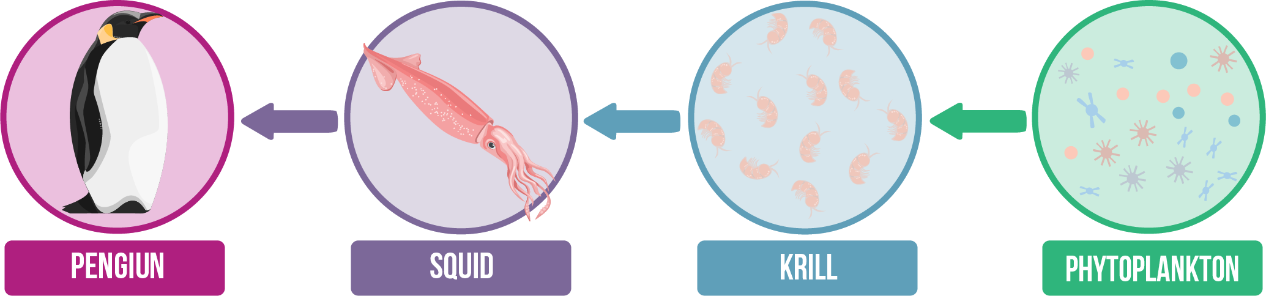
The direction of the arrows in a food chain and a food web is very important, but it is also a very common mistake. The two examples above are drawn in opposite directions. It’s important not to assume that the producers will always be on the left—always check the arrows!

Slide 11
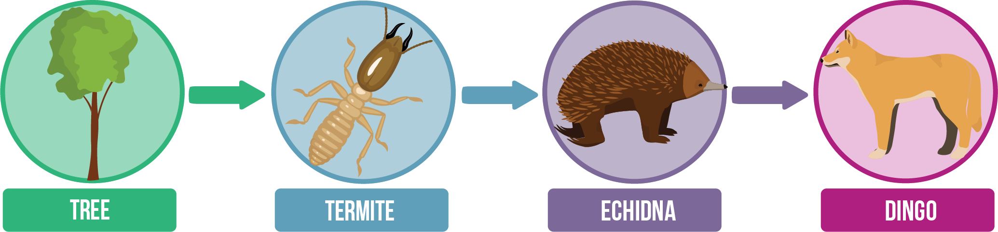
Food chains can provide information about the trophic level of each of the species.
The starting point of the food chain is the first trophic level, and each step of the food chain is another trophic level.
The food chain above tells us that trees (which can use energy from the sun) are eaten by termites, which are eaten by echidnas, which are eaten by dingos. With this information, we can determine the trophic level that each of these species fit into:

Slide 12
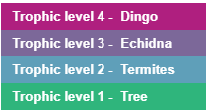

Slide 13
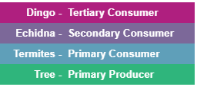
Food chains can help us classify producers and consumers.
The starting point of the food chain is the first trophic level and is, therefore, a primary producer. The second step of the food chain is the second trophic level and includes primary consumers. The third step includes secondary consumers, then tertiary consumers in the fourth step. Food chains with five steps will have a quaternary consumer as the fifth step.
Let’s use this information to classify each of the species of our food chain.

Slide 14
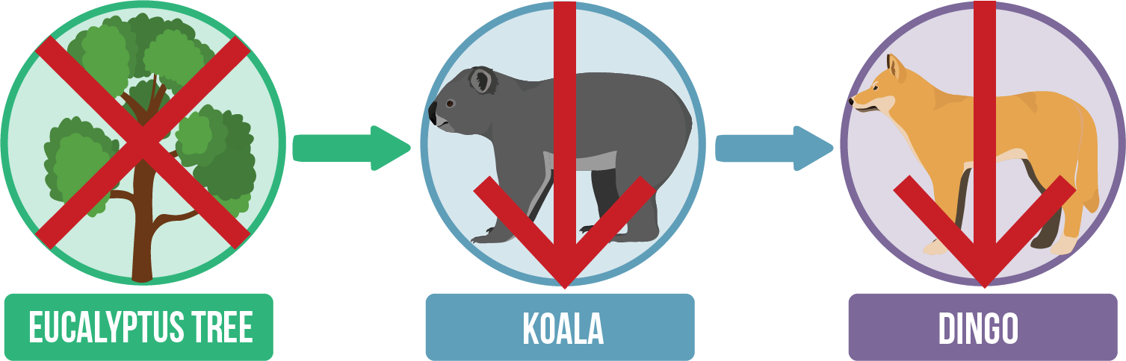
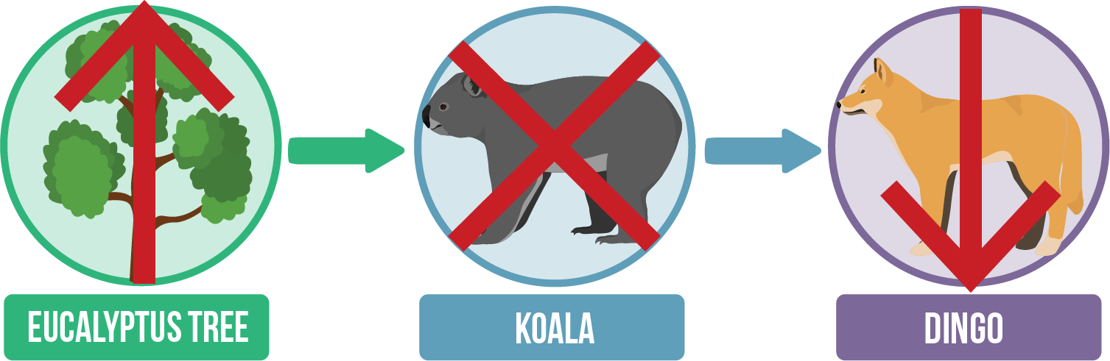
Food chains can also help us to make predictions about the effects of ecosystem changes.
If a primary producer is wiped out, all the species that rely on the energy from these producers will also rapidly decline, unless they can find another source of food.
For example, if a drought causes a significant loss of plant life in an ecosystem, primary consumers will decline due to a lack of available food. As these species begin to decline the secondary and tertiary consumers will also have a lack of available food.
If a primary consumer (second trophic level) is removed from an ecosystem, the producer in the food chain will increase in population, and the secondary consumer will decrease in population.

Slide 15
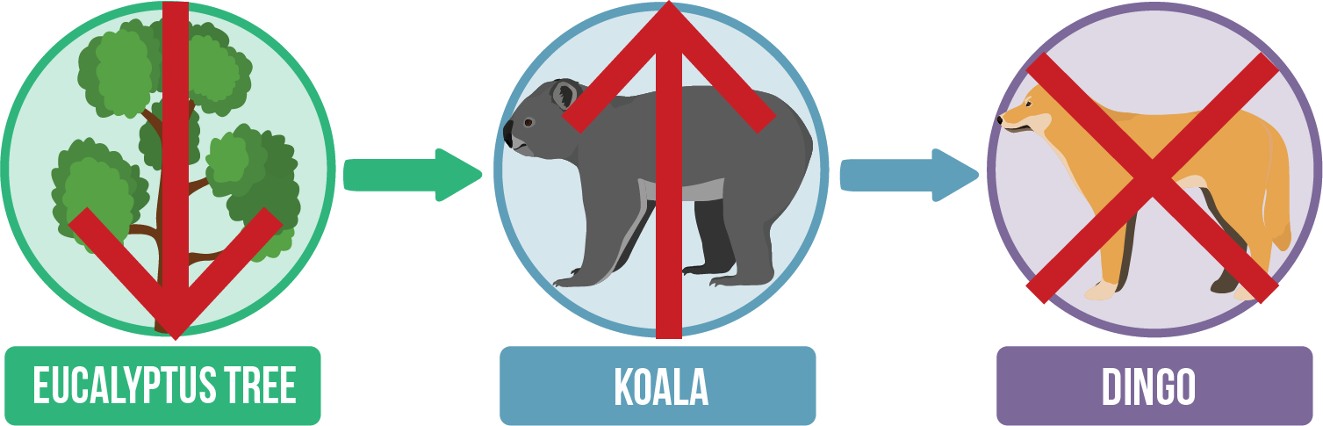
Alternatively, a decrease in the population of the secondary consumers may increase the population of the primary consumers, but this can then cause a decrease in the producer population, as there will be more primary consumers that can eat more plants.

Slide 16
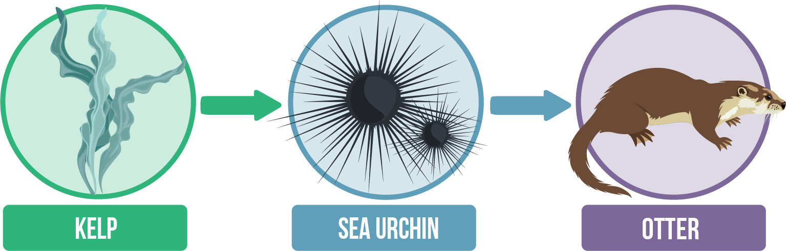
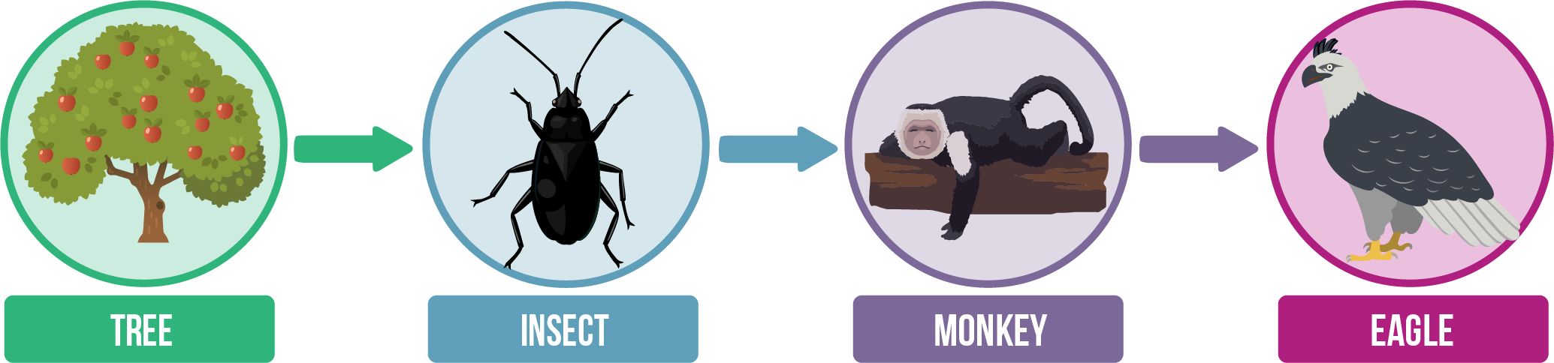
Humans are often the cause of these food chain disruptions.
One classic example is the commercial harvesting of sea otters for their fur in Alaska. Sea otters in the area mostly preyed upon marine invertebrates such as sea urchins. When the otter population declined, the sea urchin population increased, causing significant damage to kelp forests.
Similarly, when rainforests are deforested, the number of trees to provide food for primary consumers is dramatically reduced. As these trees are removed, the number of primary consumers will decrease, resulting in a decrease in the number of species at every other level.

Slide 17
Food chains are very simplified models of what is actually happening in the ecosystems.
Because they are so simple, there are several limitations that we should keep in mind when we’re using food chains to describe ecosystems or predict changes in ecosystems.
Food chains imply that a consumer gets all of its energy from a single source, when in reality it may have many different food sources.
Similarly, the food chains suggest that a particular species has only one predator, whereas they might have multiple predators.
A food chain puts each species into a single trophic level, whereas many species can be categorized in multiple trophic levels, such as bird species that consume plants as well as insects.
Making predictions from food chains doesn't consider the effects of other species in the ecosystem.

Slide 18
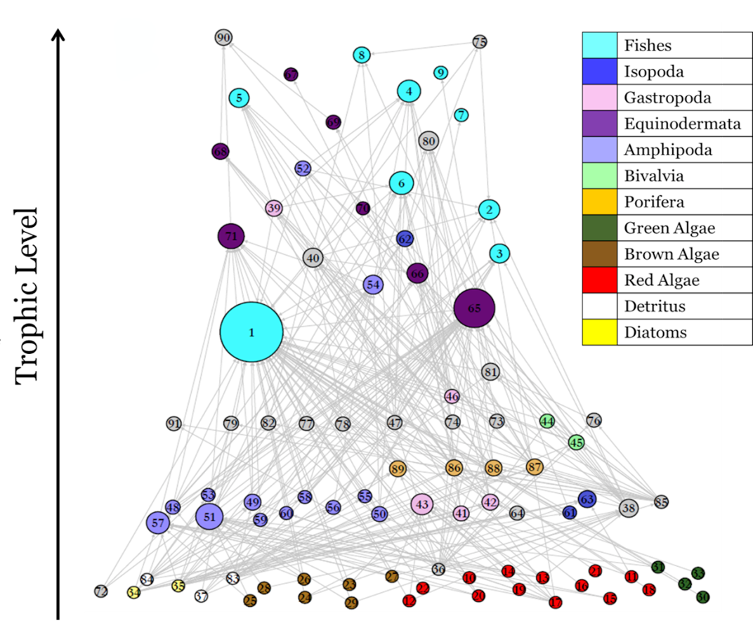

Slide 19
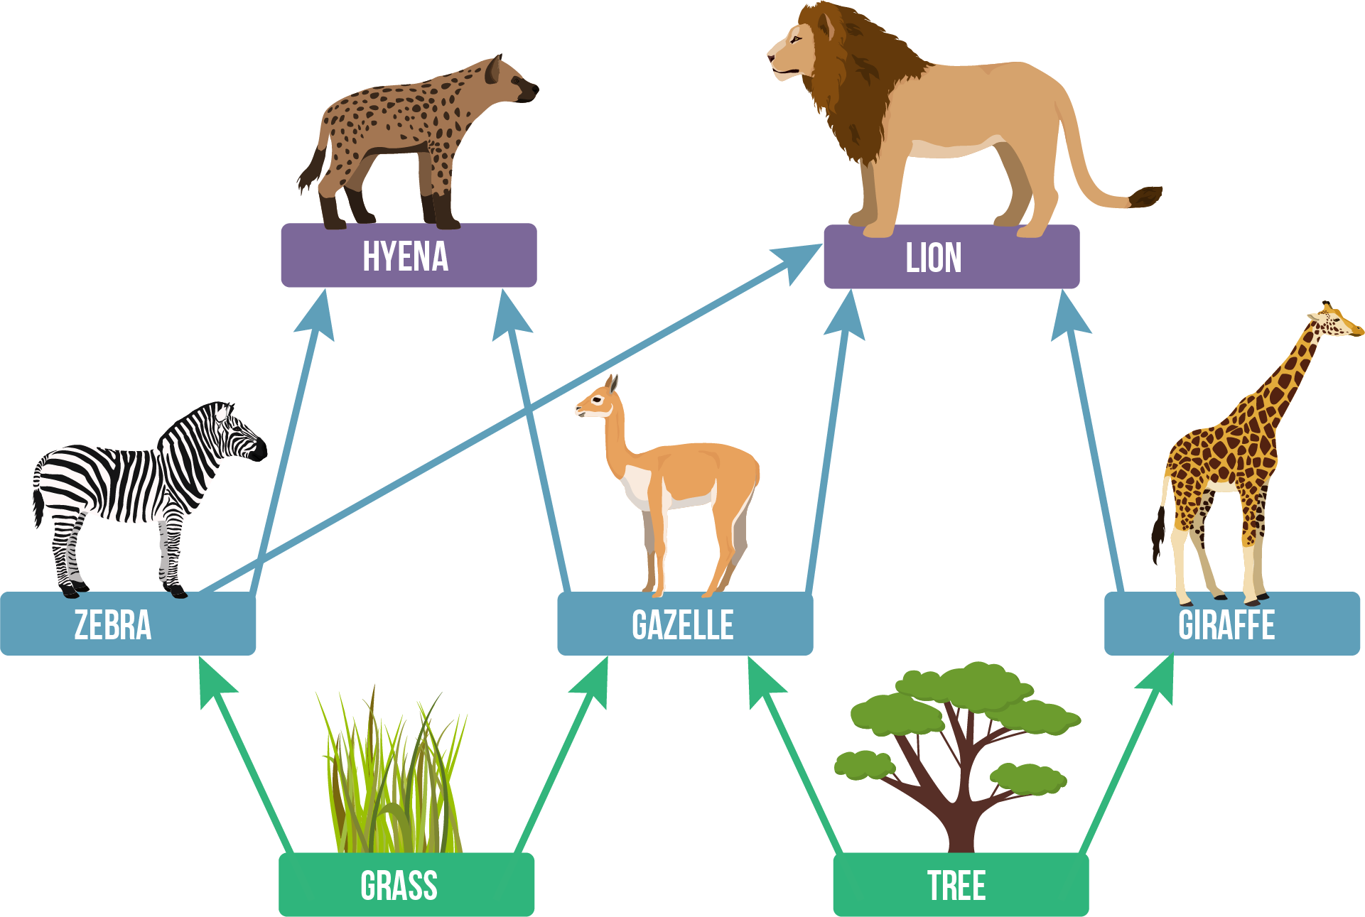
What is a food web?
Lions eat zebras, and zebras eat grass. This is an example of a food chain. But lions also eat gazelle and giraffes, and zebras have other predators such as hyenas.
It turns out that food chains aren’t really telling the whole story. A more accurate depiction of energy flow within an ecosystem is a food web. A food web represents multiple pathways of energy flow through an ecosystem. You can think of these as a web of multiple, interconnected food chains.

Slide 20
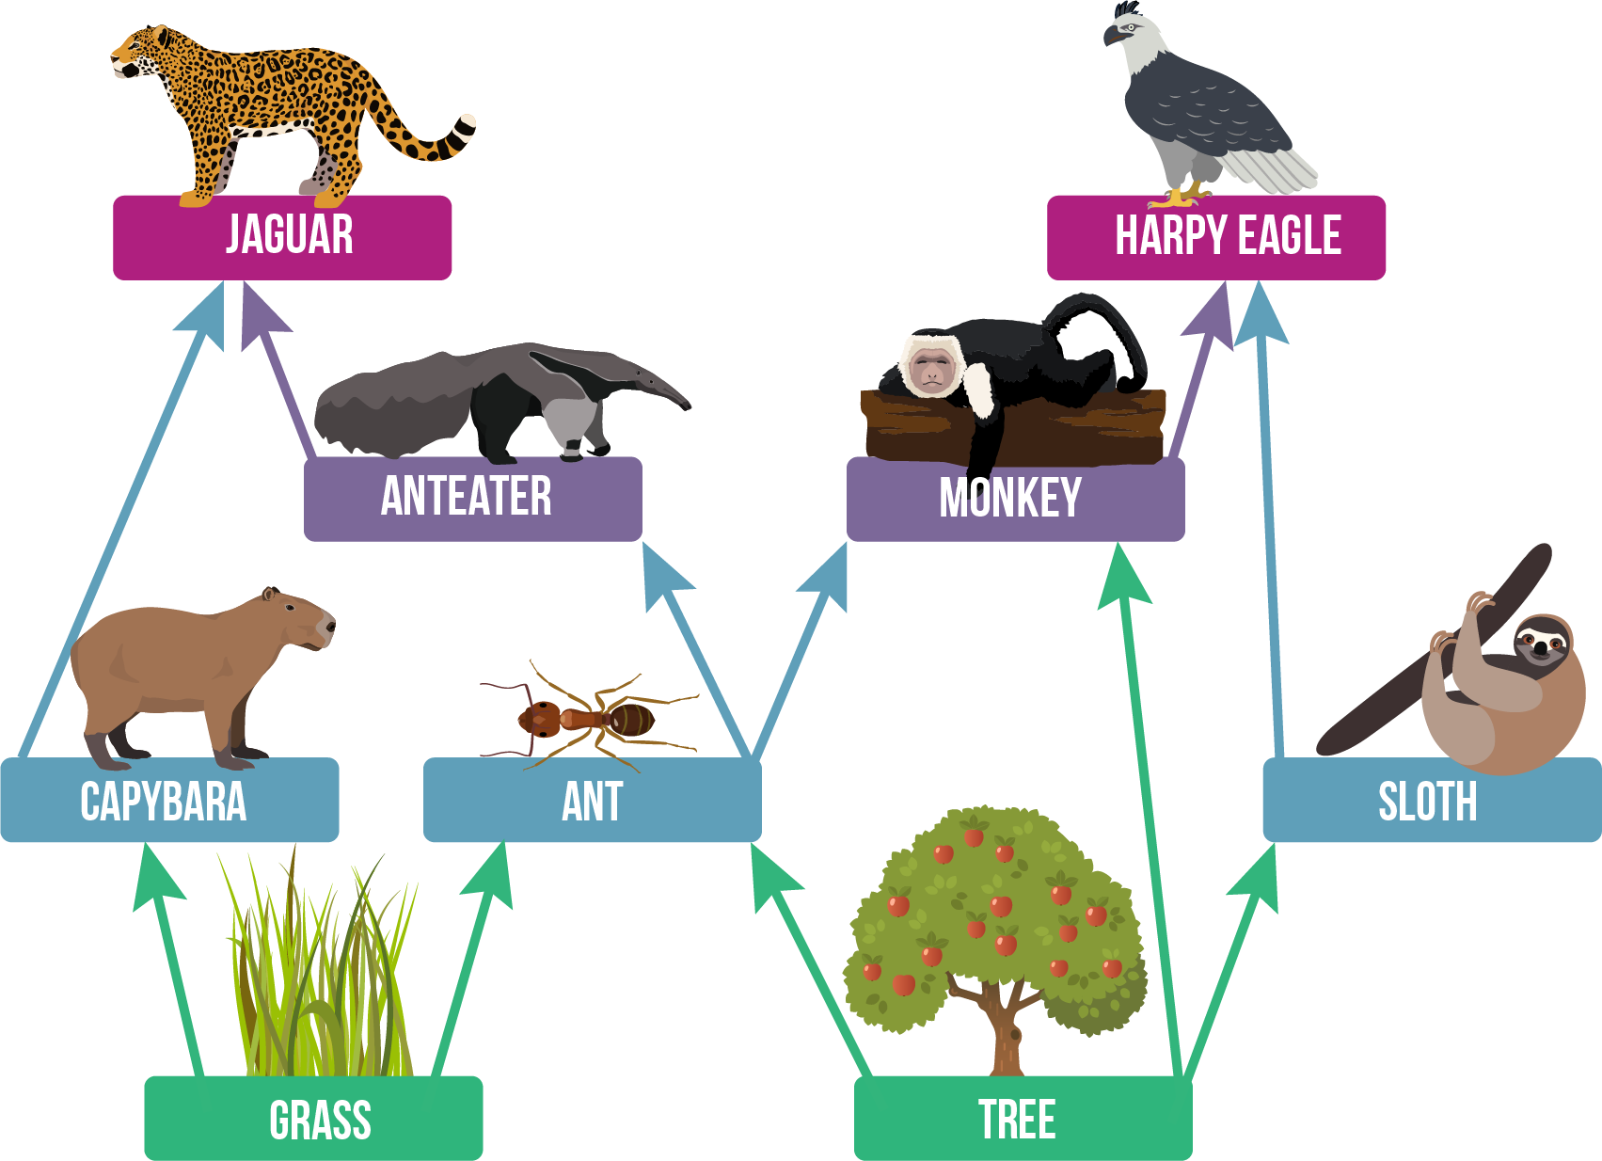
Just like food chains, food webs can tell us about the trophic level of each species.
For example, the food web below shows us that grasses and trees are primary producers, capybara, sloths and ants are all primary consumers, and anteaters, jaguars, harpy eagles and monkeys are all secondary consumers. However, because anteaters and monkeys are secondary consumers, their predators, the jaguars and eagles must also be tertiary consumers.
Most consumers eat a variety of different organisms, therefore some consumers can fit in more than one trophic level.
For example, omnivores are animals that eat both plants (primary consumers) and animals (secondary consumers) and could, therefore, fit on the second and third trophic levels.
In the food web above, monkeys eat fruit from fruit trees as well as insects like ants, making them omnivores and putting them on the second and third trophic levels. Similarly, a large carnivore may eat some primary consumers, some secondary consumers, and some tertiary consumers. Therefore they would fit on the third, fourth and fifth trophic levels.

Slide 21
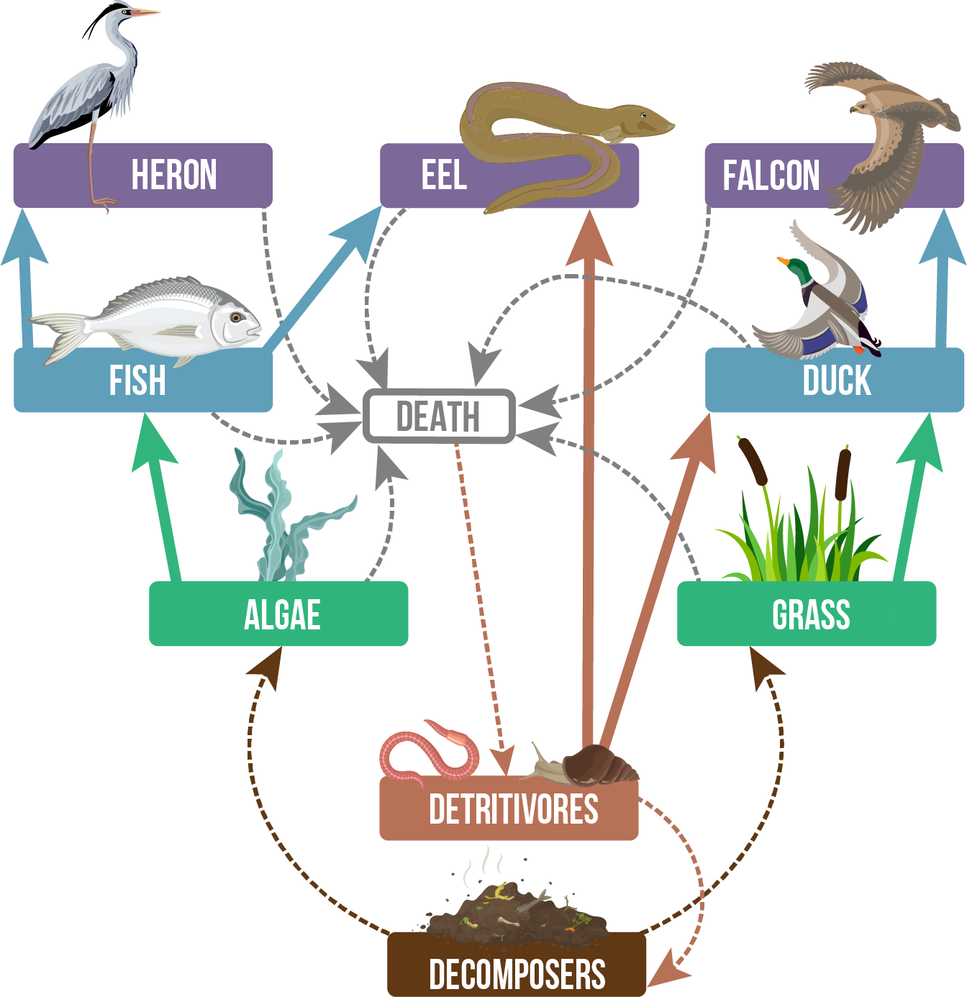
So far in this lesson, we have discussed the roles of producers and consumers in food webs, but we’re missing a couple of important team members: detritivores and decomposers.
Detritivores ingest dead or decomposing organic matter such as rotting plants, animal remains, and even dung. Detritivores include animals such as insects, slugs and worms, as well as some starfish, sea cucumbers and crabs.
Decomposers take the process one step further by breaking down the organic matter into simple molecules that they can absorb, or leave to be returned to the environment and used by other organisms. Decomposers have an important role in turning decaying organic matter into nutrients that enrich the soil. Various species of fungi and bacteria belong to this group of organisms.

Slide 22
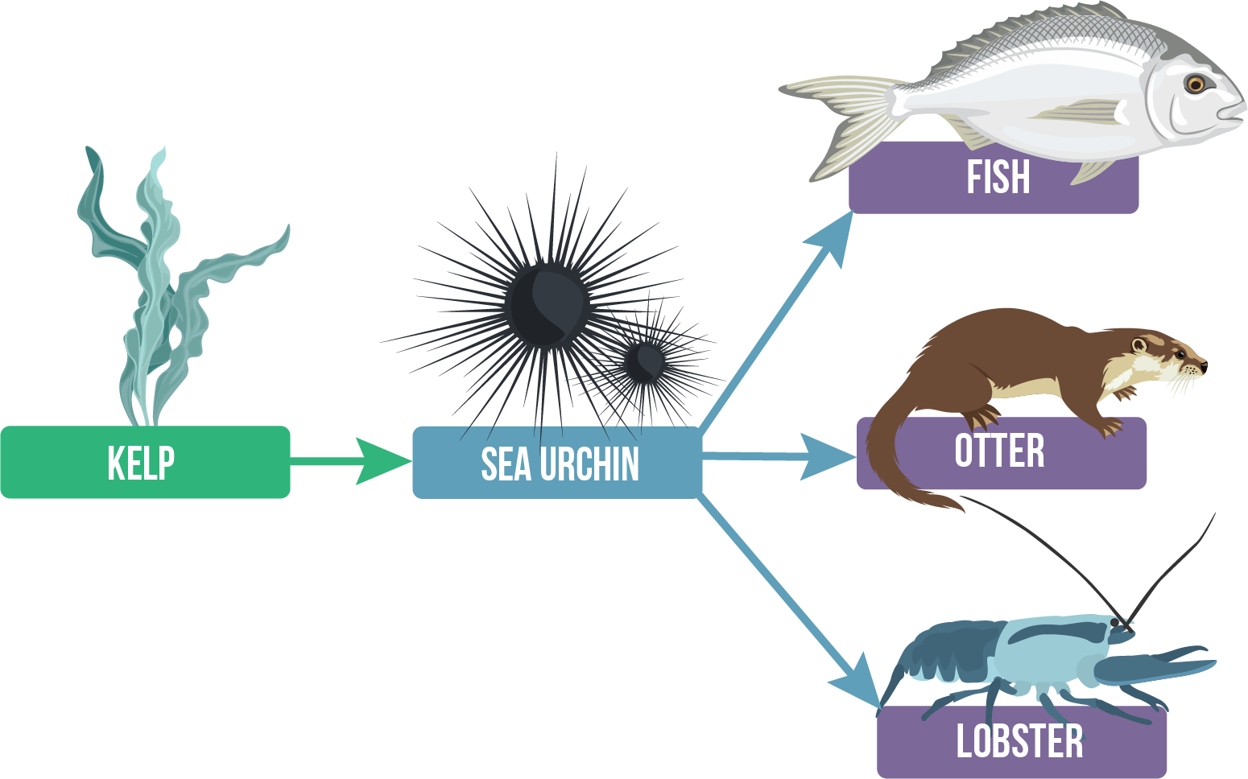
When we start linking up all of the producers, consumers, decomposers and detritivores in an ecosystem, we start to see how complex these food webs really are.
Fortunately, more complex food webs are usually more stable. Remember the sea urchins that destroyed the kelp forests because the otters were overharvested? In other areas around North America, kelp forests were not impacted by the overharvesting of sea otters. In these areas, sea urchins were eaten by a number of other predators such as lobsters and large fish. Therefore, when the otter population declined, these other predators kept the sea urchin population down and protected kelp forests.
In other words, the food web was more complex in these areas, and therefore the ecosystem was more stable and less impacted by the removal of a single species.

Slide 23
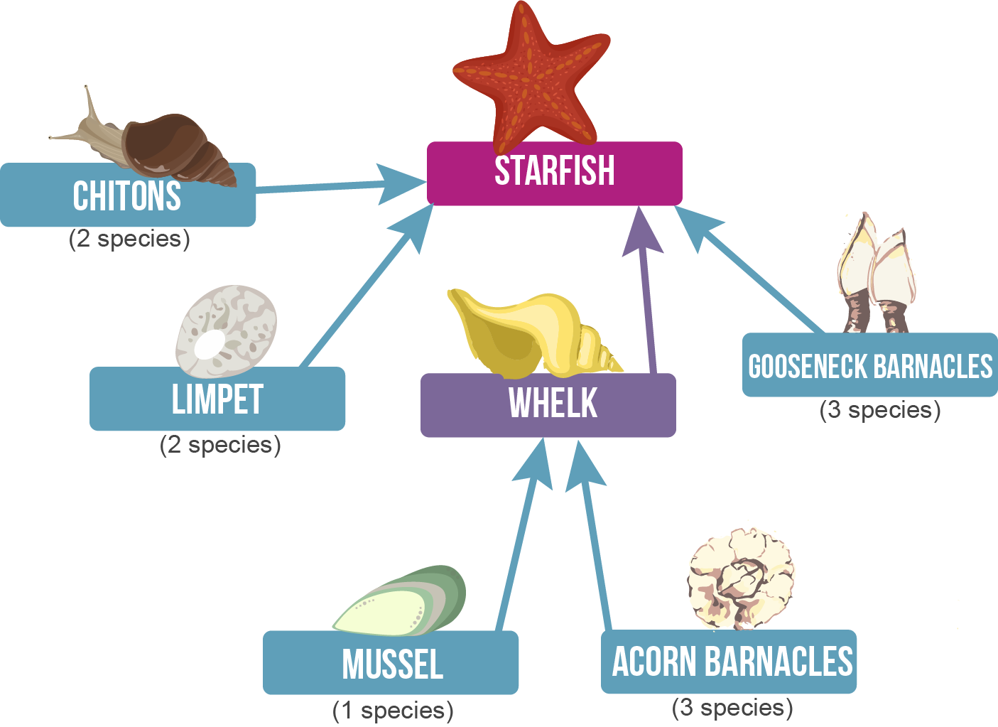
However, as food webs become more complex, it also becomes more difficult to make predictions about what happens when species are removed.
The food web below is a relatively simple one and contains only one tertiary consumer, a starfish. If this food web was divided into separate food chains, we might predict that the removal of the starfish would increase the population of each of the species it eats. But often, the predictions we make using food chains are inaccurate when we consider the rest of the food web.
A study by Robert Paine (1969) found that by removing the starfish from this community, the number of prey species dropped. With the absence of a predator, the larger prey species began to out-compete the smaller species for food and space, reducing the biodiversity of the community.

Slide 24
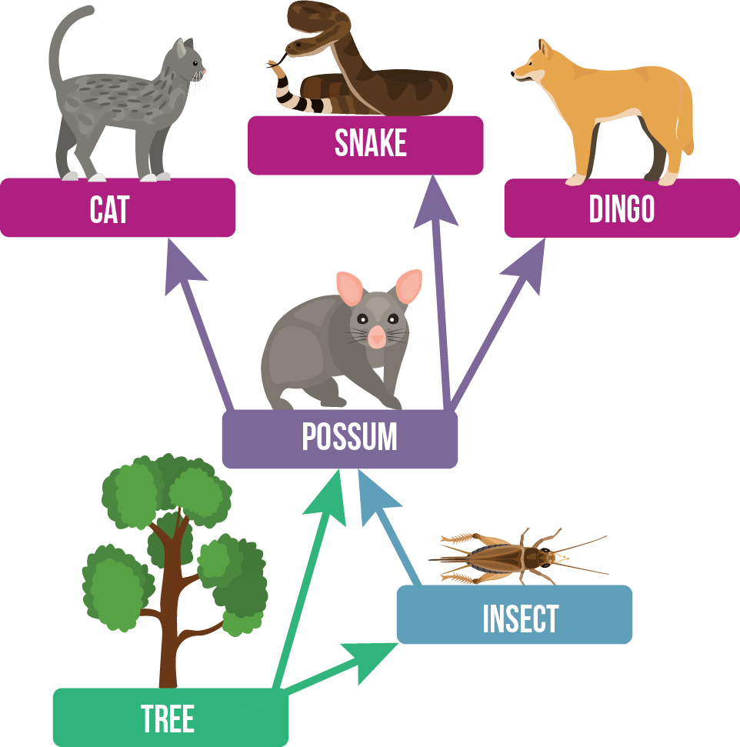
We’ve discussed the impacts of removing a species from food webs and food chains, but what happens when we try to add one in?
The common brushtail possum was introduced from Australia to New Zealand in the 1850s, and has now spread throughout the entire country. Take a look at these two food webs; on the left is an Australian food web, and below is a New Zealand food web.
In Australia, possums prefer eucalyptus leaves but are able to eat many different kinds of plants, and will occasionally eat insects. However, they also have a number of predators in Australia, including both native and introduced species.

Slide 25
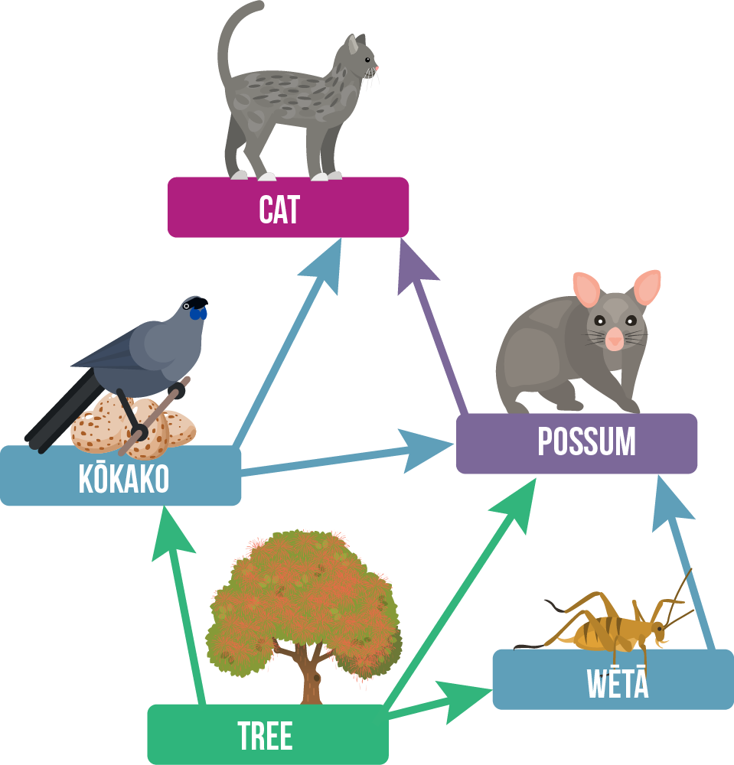
Possums in New Zealand prefer broadleaved trees such as the rātā and can cause significant damage to many native plant species. They are also out-competing native birds, resulting in the decline of these native species. Possums have also been observed eating native insects such as wēta and the eggs of native birds such as the kōkako.
In these ways, the possum has completely disrupted food webs in New Zealand. The lack of predators and abundance of nutritious food has meant that possums thrive in New Zealand forest.

Slide 26
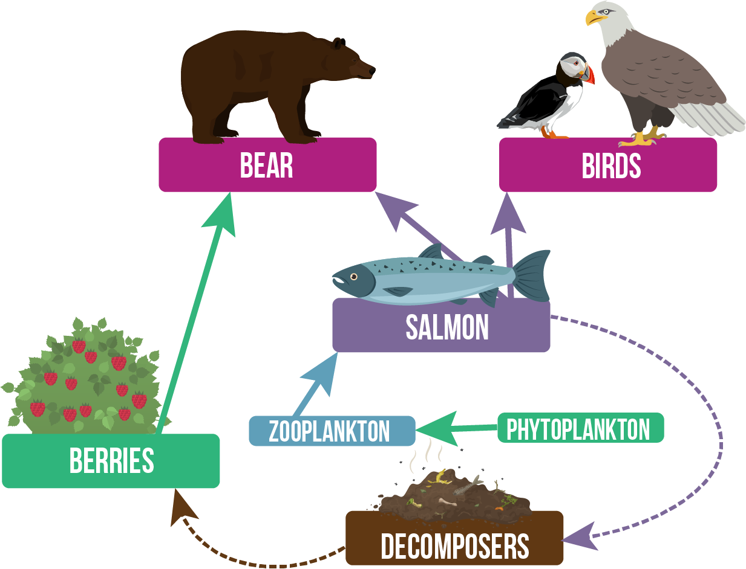
The effects of climate change can cause changes in the populations of certain species, but can also impact the timing of seasonal patterns.
Food webs don’t just exist in the same space, they also exist at the same time. The food that one organism eats may change throughout the year, depending on what is available.
One example of this is the Kodiak bear, which feeds on salmon during summer, then later in the year will move away from the streams into the hills to eat berries, which ripen at the end of the salmon season. However, warmer weather due to climate change has resulted in the berries ripening earlier, and the bears have abandoned the streams to eat more berries.
As the bears eat more berries and fewer salmon, the other species that are also reliant on the berries are likely to decrease as they are out-competed by the large bears. Some species also relied on the bears to pull the salmon out of the streams so they could scavenge and decompose the nutrient-rich salmon meat. Even local tree species benefit from the abundance of nutrients from the salmon that enrich the soil.

Slide 27
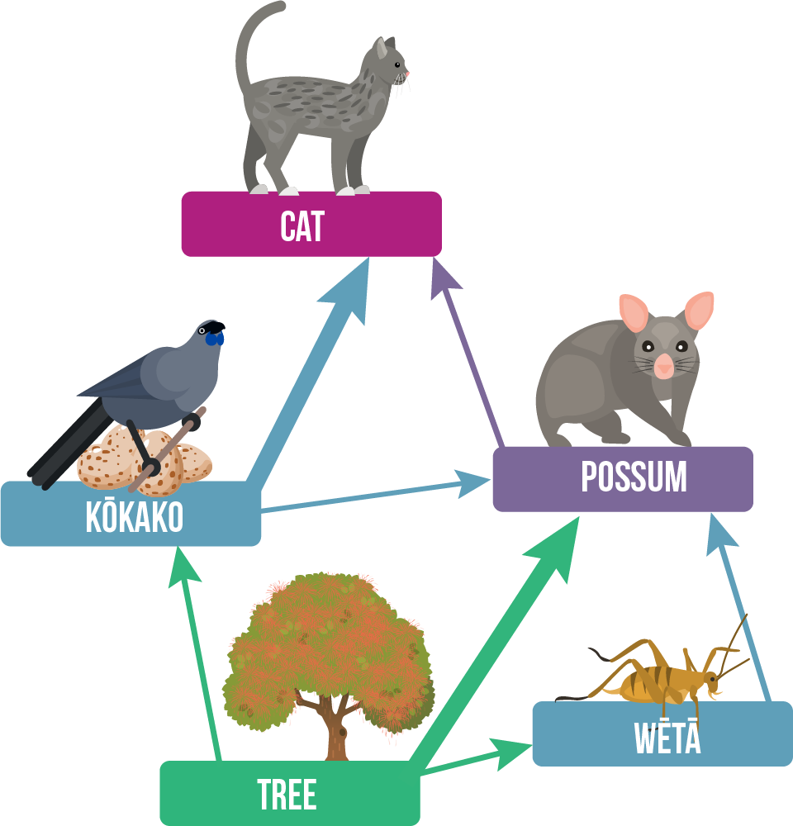
Although food webs are more complex than food chains, they still don’t tell the whole story.
Food webs don’t tell us the population sizes of each species, and therefore the number of organisms at each trophic level.
We also don’t know how common the different predator-prey relationships are. For example, does a predator favour one species of prey over another?
Do these relationships change during the year, as different species become more or less common?
Most food webs don’t include parasites as that would make things a lot more confusing, however, these species are an important part of real-life food webs.
Of course, all of these limitations of food webs are also limitations of food chains. Therefore it is important to keep all of these limitations in mind when deciding which model is best for displaying the information you need or making predictions based on these models.

